Slide 1

Bias in Clinical Research
Yasser Albogami, MPH, Ph.D.
PHRM 414
Lecture, 2023

Slide 2
Objectives
Recap
Basics of Confounding
Overview on selection bias
Overview on measurement bias

Slide 3
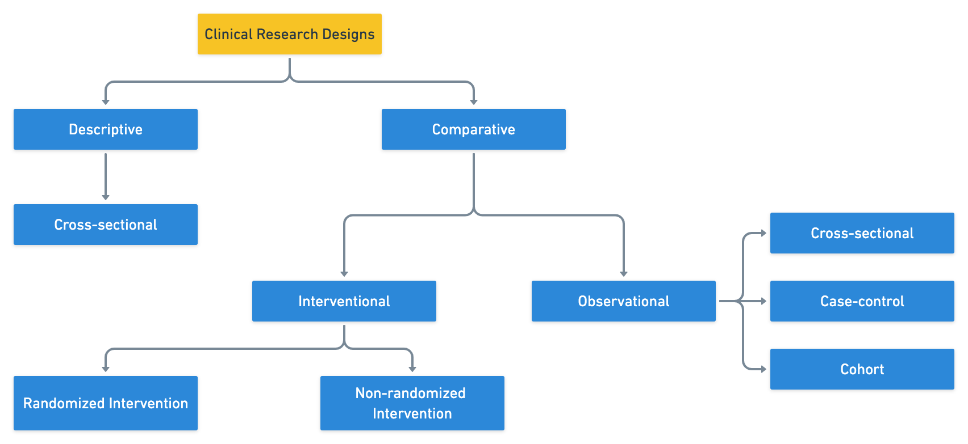
Recap

Slide 4
Chance, bias and causality
On their twitter and snapchat accounts, the CNN reported that a recent study showed that drinking coffee may cause cancer.
Chance? Bias? Causal?
No
No
Statistics
Epidemiology

Slide 5
Bias in epidemiology
Generally, biases can be classified into one of the following types:
Confounding
Selection Bias
Measurement Bias

Slide 6
Confounding

Slide 7


Confounding
Confounding is defined as a distorted relationship between two variables caused by a third variable. A confounder is the variable that distorts the association between two variables.
A study found that being a firefighter was associated with less heart disease compared to the general community they serve.
Does being a firefighter decrease your risk of developing heart diseases?

Slide 8
Confounding
Fitness
X
The association was distorted by a third variable. Being physically fit increases your chance to get accepted into organizations that provide firefighting services; it also prevents heart diseases.

Slide 9
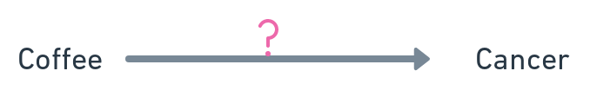
Confounding
Does drinking coffee cause cancer?
Observational studies have shown that coffee consumption may increase the risk of having cancer.
Is the association TRUE (causal) or FALSE (biased)?

Slide 10
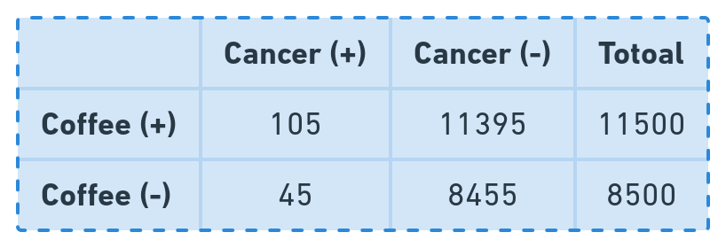
Confounding
Hypothetically, we surveyed 20,000 residents from Riyadh city and collected their health and behavioral information. We then compared cancer risk between coffee drinkers and non-drinkers.
Observed Relative Risk =

Slide 11
Confounding
Hypothetically, we surveyed 20,000 residents from Riyadh city and collected their health and behavioral information. We then compared cancer risk between coffee drinkers and non-drinkers.
Observed Relative Risk = 1.7

Slide 12
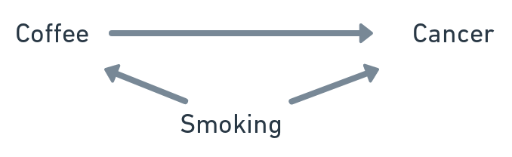
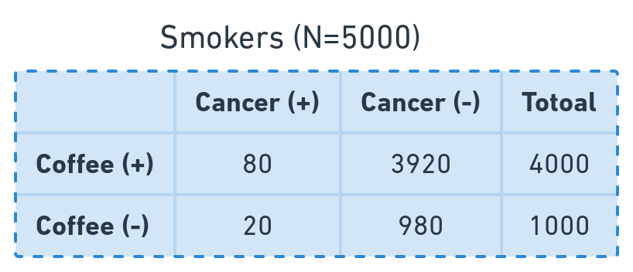
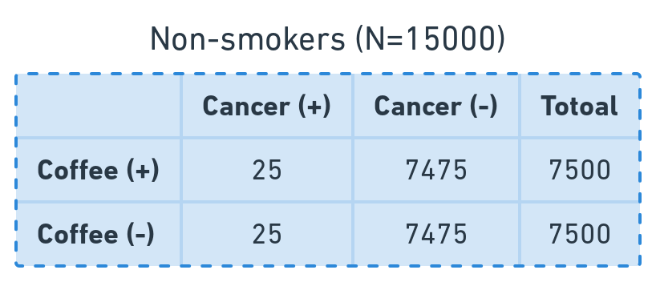
Confounding
X
Observed Relative Risk = 1.00
Observed Relative Risk = 1.00

Slide 13
Confounding
X
80%
50%
Observed Relative Risk = 1.00
Observed Relative Risk = 1.00

Slide 14
Confounding
X
80%
50%
2%
0.3%
Observed Relative Risk = 1.00
Observed Relative Risk = 1.00

Slide 15
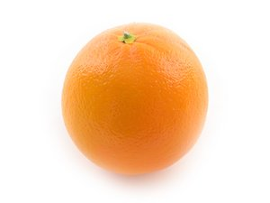
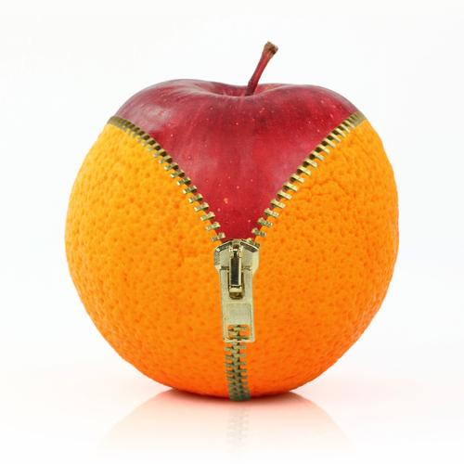
Confounding
Confounding is an essential concept in observational studies that always must be addressed. Why?
We always want the two samples we compare to be exchangeable (similar), as randomization does in randomized clinical trials. If in one group we have older participants or participants with high body mass index, then we are not comparing orange to orange.
Vs

Slide 16
Confounding in pharmacoepidemiology
The way drugs are being prescribed introduces bias in observational studies which is referred to as confounding by indication.
Physicians prescribe SSRI to treat depression. Can we compare SSRI users and non-users to evaluate suicide risk? Why?

Slide 17
Confounding in pharmacoepidemiology
The way drugs are being prescribed introduces bias in observational studies which is referred to as confounding by indication.
Physicians prescribe SSRI to treat depression. Can we compare SSRI users and non-users to evaluate suicide risk? Why?
Depression
SSRI use
Suicide Risk

Slide 18

Confounding in pharmacoepidemiology
A study found that using aspirin increases the risk of developing stroke. The authors concluded that using aspirin may harm older patients who are at a higher risk of stroke.

Slide 19
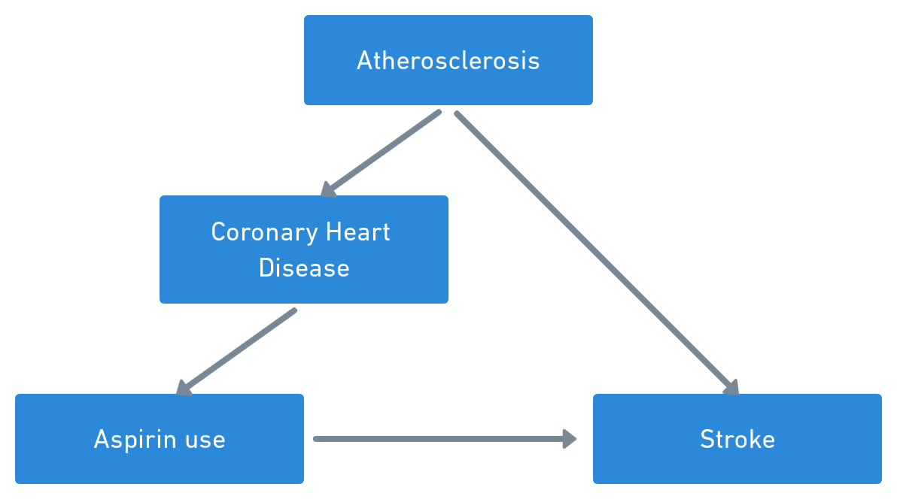
Confounding in pharmacoepidemiology
X
Atherosclerosis, a third variable, distorted the association between aspirin use and stroke. Atherosclerosis causes coronary heart disease which is an indication to initiate aspirin; it also causes stroke. This type of confounding is referred to as confounding by indication

Slide 20
How to think of potential confounders in my study?

Slide 21
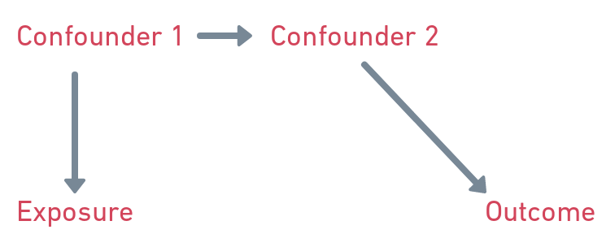
Confounding Criteria
To be considered as a confounder, variables require to meet the following characteristics:
1- Causing the outcome (or associated with a variable that causes the outcome).
2- Causing the exposure (or associated with a variable that causes the exposure).
3- Not caused by the exposure or the outcome.

Slide 22
Addressing Confounding
We first start by identifying the potential confounders. This is done by understanding why, where, how and to whom the exposure (or drug) is being prescribed and what factors could cause the outcome in our population. Literature, clinical guidelines, patients and prescribers are good resources to start with to create your lists of potential confounders.

Slide 23
Addressing Confounding
Confounders can be:
Known and measured:
we know they are potential confounders and are measured.
Known but unmeasured:
we know they are potential confounders but are not measured.
Unknown and unmeasured:
we don’t know they are potential confounders and are not measured.
In observational studies, we always can mitigate the impact of confounders but we never can eliminate it unlike randomized clinical trials. Why?

Slide 24
Addressing Confounding (Design stage)
1- While writing your study protocol, your decision to select a comparator group determines the magnitude of confounding.
Use Vs Non-use comparison always the risk of confounding.
A good comparator would share the following with exposure:
  Indication
  Adverse effects
  Contraindication
A good comparator mitigates both measured and unmeasured confounders.
2- Restriction: SSRI Vs Non-SSRI and suicide risk restricted to patients with depression. It only mitigates the measured confounder.

Slide 25
Addressing Confounding (Analysis stage)
While writing your study protocol, think about ways to mitigate the measured confounders during the analysis stage.
1- Stratification: Coffee and Cancer risk stratified by smoking status
2- Matching: Coffee Vs Cancer matched based on smoking status
What if we have tens or hundreds of confounders in our study?
3- Regression model:
It is able to control for multiple measured confounders

Slide 26
Addressing Confounding
Which methods will you use to adjust for > 20 or > 100 or > 1000 potential confounders?

Slide 27
Addressing Confounding
Which methods will you use to adjust for > 20 or > 100 or > 1000 potential confounders?
Regression and Propensity Score

Slide 28
SIMPSON PARADOX
Hypothetical scenario:
A new drug (Drug A) has been prescribed to COVID-19 patients to prevent death. Other COVID-19 patients were prescribed older drug (Drug B). Your research team has been requested to estimate whether Drug A prevents death significantly compared to Drug B.
The data your team gathered are:
1- T: Type of drug (Drug A=1, Drug B=0)
2- Y: The outcome (died=1 or alive=0)
3- C: COVID-19 infection severity (mild=0, severe=1)
ID | T | Y | C
1 | 1 | 0 | 1
2 | 1 | 0 | 1
3 | 0 | 1 | 1
4 | 1 | 1 | 0
X | 0 | 0 | 1

Slide 29
SIMPSON PARADOX
Hypothetical scenario:
 |  | Death count | Total | P(T|Y=1)
Treatment | A | 240 | 1500 | 0.16
 | B | 105 | 550 | 0.19
COVID-19 Severity: Mild COVID-19 Severity: Severe
 |  | Death count | Total | P(T|Y=1)
Treatment | A | 210 | 1400 | 0.15
 | B | 5 | 50 | 0.10
 |  | Death count | Total | P(T|Y=1)
Treatment | A | 30 | 100 | 0.30
 | B | 100 | 500 | 0.20

Slide 30
SIMPSON PARADOX
Hypothetical scenario:
 |  | Death count | Total | P(T|Y=1)
Treatment | A | 240 | 1500 | 0.16
 | B | 105 | 550 | 0.19
Simpson Paradox
COVID-19 Severity: Mild COVID-19 Severity: Severe
 |  | Death count | Total | P(T|Y=1)
Treatment | A | 210 | 1400 | 0.15
 | B | 5 | 50 | 0.10
 |  | Death count | Total | P(T|Y=1)
Treatment | A | 30 | 100 | 0.30
 | B | 100 | 500 | 0.20

Slide 31
SIMPSON PARADOX
Which results will you believe in and report to the agency that hired you? Why?
 |  | Death count | Total | P(T|Y=1)
Treatment | A | 240 | 1500 | 0.16
 | B | 105 | 550 | 0.19
COVID-19 Severity: Mild COVID-19 Severity: Severe
 |  | Death count | Total | P(T|Y=1)
Treatment | A | 210 | 1400 | 0.15
 | B | 5 | 50 | 0.10
 |  | Death count | Total | P(T|Y=1)
Treatment | A | 30 | 100 | 0.30
 | B | 100 | 500 | 0.20

Slide 32
SIMPSON PARADOX
Which results will you believe in and report to the agency that hired you? Why?
It depends on how and when your data were generated

Slide 33
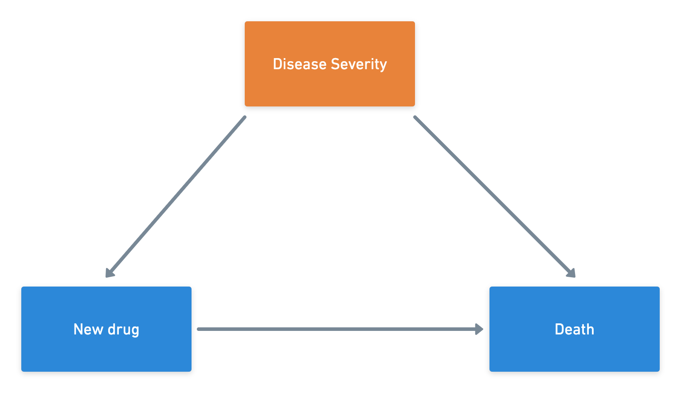
SIMPSON PARADOX
Which results will you believe in and report to the agency that hired you? Why?
It depends on how and when your data were generated
Does being severe patients make the prescribers give the patients drug b?
If yes, then disease severity is a confounder.
The team should report the sub-group results.

Slide 34
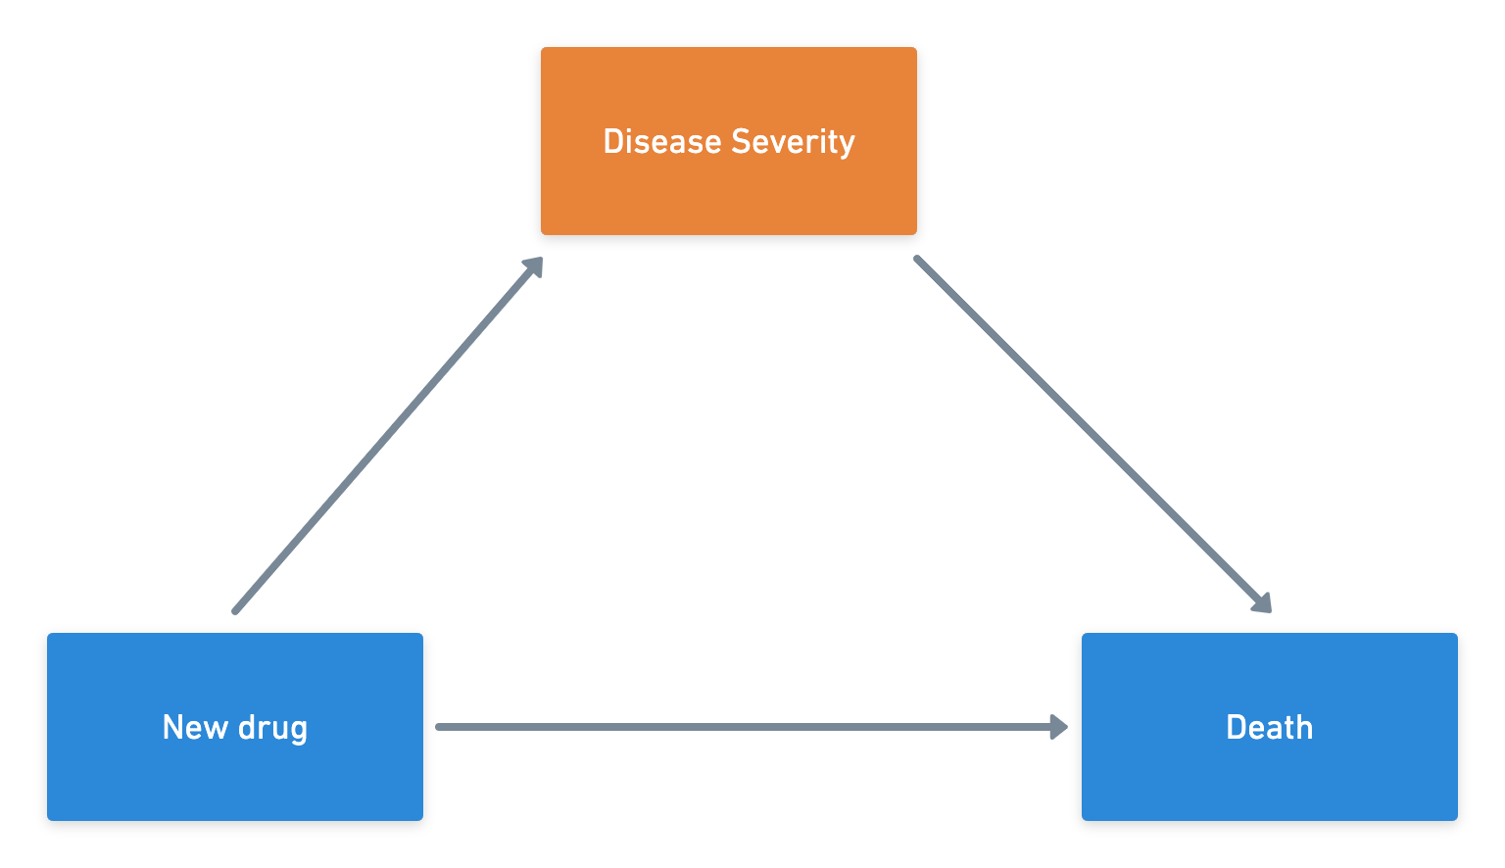
SIMPSON PARADOX
Which results will you believe in and report to the agency that hired you? Why?
It depends on how and when your data were generated
If drug b is limited and patients need to wait for a longer period of time compared to those who received
drug a, then disease severity is an intermediate and not a confounder.
The team should report the overall results, not the sub-group.

Slide 35
Selection Bias

Slide 36

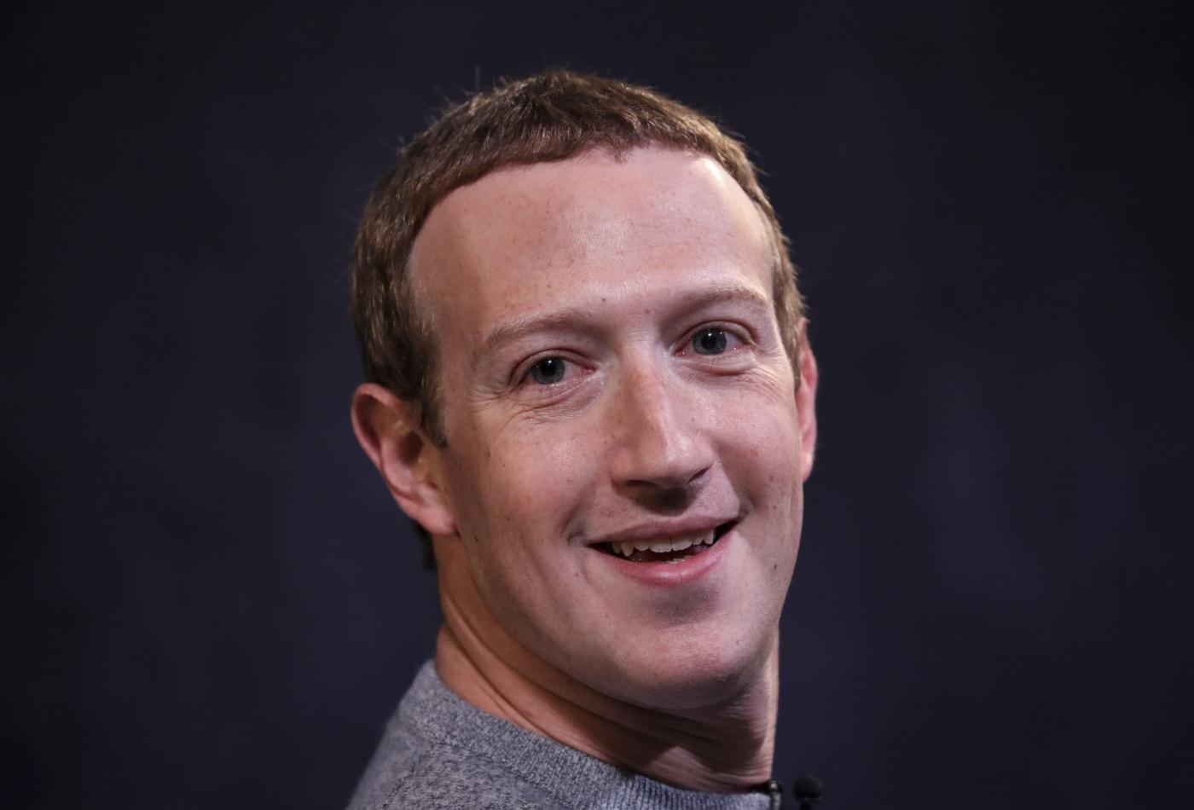
What is selection bias?
A college degree isn’t necessary to be successful. REALLY?

Slide 37
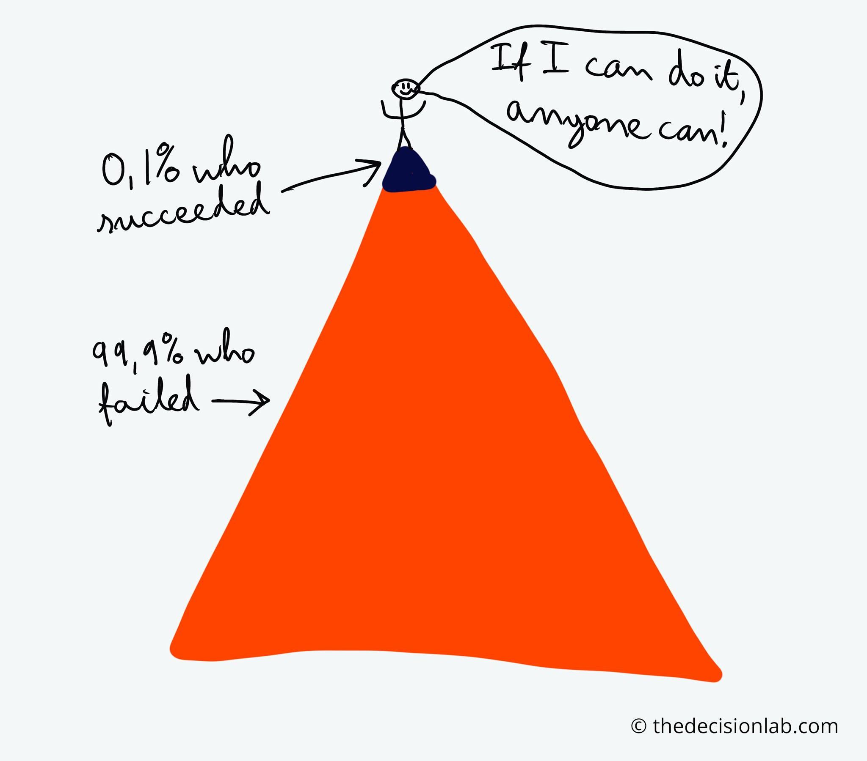
What is selection bias?

Slide 38
What is selection bias?
Selection bias is a distortion that resulted from procedures used to select study participants.
Major types of selection bias in Pharmacoepidemiology:
Self-Selection Bias
Prevalent Users Bias
Non-Responders Bias

Slide 39
Self-Selection Bias
It arises when the patients choose (by themselves or their caregivers) to participate in a study depending on their knowledge of their outcome.
Example:
You are asked to conduct a retrospective study to evaluate paracetamol effect on birth defect.
Who would you recruit more (agree to consent), if they know the research question?
1- Women delivered a baby with a defect and used paracetamol during pregnancy.
2- Women delivered a healthy baby and used paracetamol during pregnancy.
3- Women delivered a baby with a defect but did not use paracetamol during pregnancy.

Slide 40
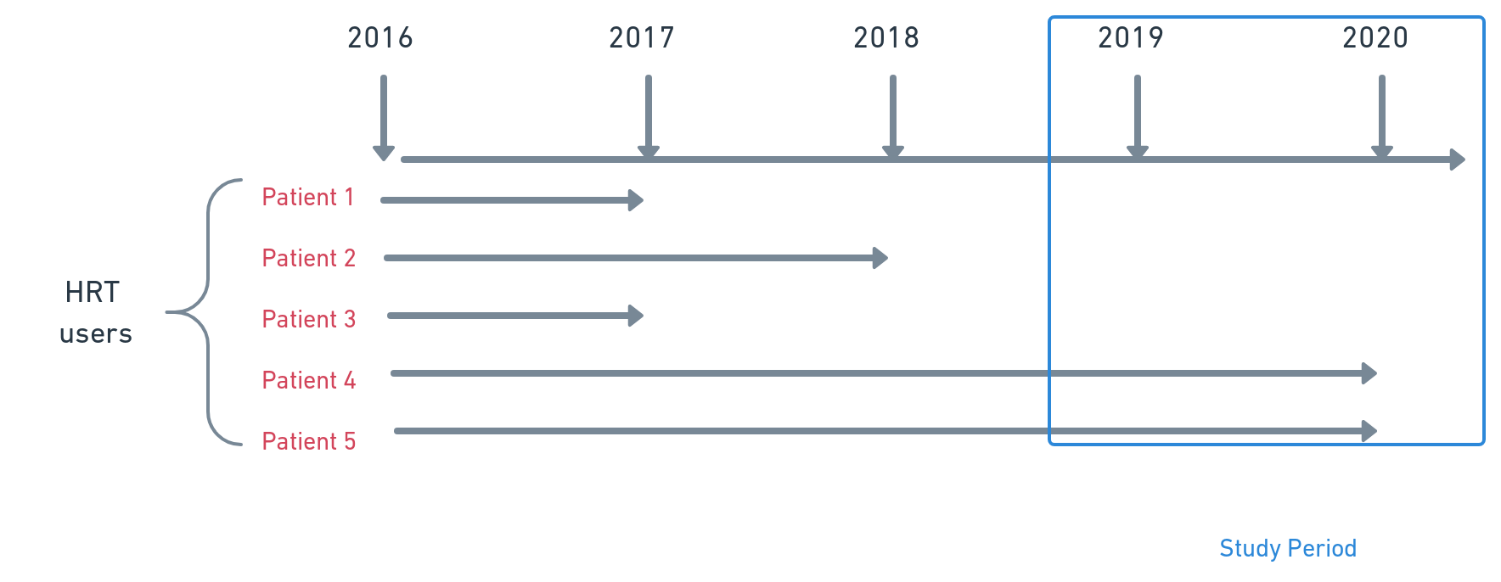
Prevalent User Bias
If researchers include patients who already been using a drug and start following them up, they probably would not find a risk increase since they already survived. They would include the survivors since patients with high risk already depleted.

Slide 41
Non-Responders bias
It occurs when people are unwilling, unable or not engaged to respond to a survey due to a factor that makes them differ greatly from people who respond.
Online survey?
Malls survey?
Random polls on twitter?

Slide 42
How to prevent selection bias?
It can be prevented from the design stage. A good comparator group would help to prevent many selection biases.
Ensure study participants enter the study right after receiving the drug (New-Users) to avoid prevalent user bias.

Slide 43
Measurement Bias
(or information Bias)

Slide 44
Measurement Bias
Measurement bias occurs when the exposure, outcome or confounder lack perfect measurements (poorly measured).
For example, your research team assigned you to identify patients with type II diabetes from 2015-2017 using medical records.
How would you do it?
Patients who use any hypoglycemic agents?
Patients with physicians diagnosis?
Patients with specific HbA1C number?

Slide 45
Major Types of Measurement Bias
Recall Bias
Protopathic bias
Immeasurable time bias

Slide 46
Recall Bias
It mainly occurs in survey-based research in which one group recalls more information regarding exposure or outcome than the other groups.
Back to the paracetamol and birth defect example, who would recall more information to what kind of drugs they used during pregnancy?
1- The group with birth defects (cases)
2- The group without birth defects (control)

Slide 47
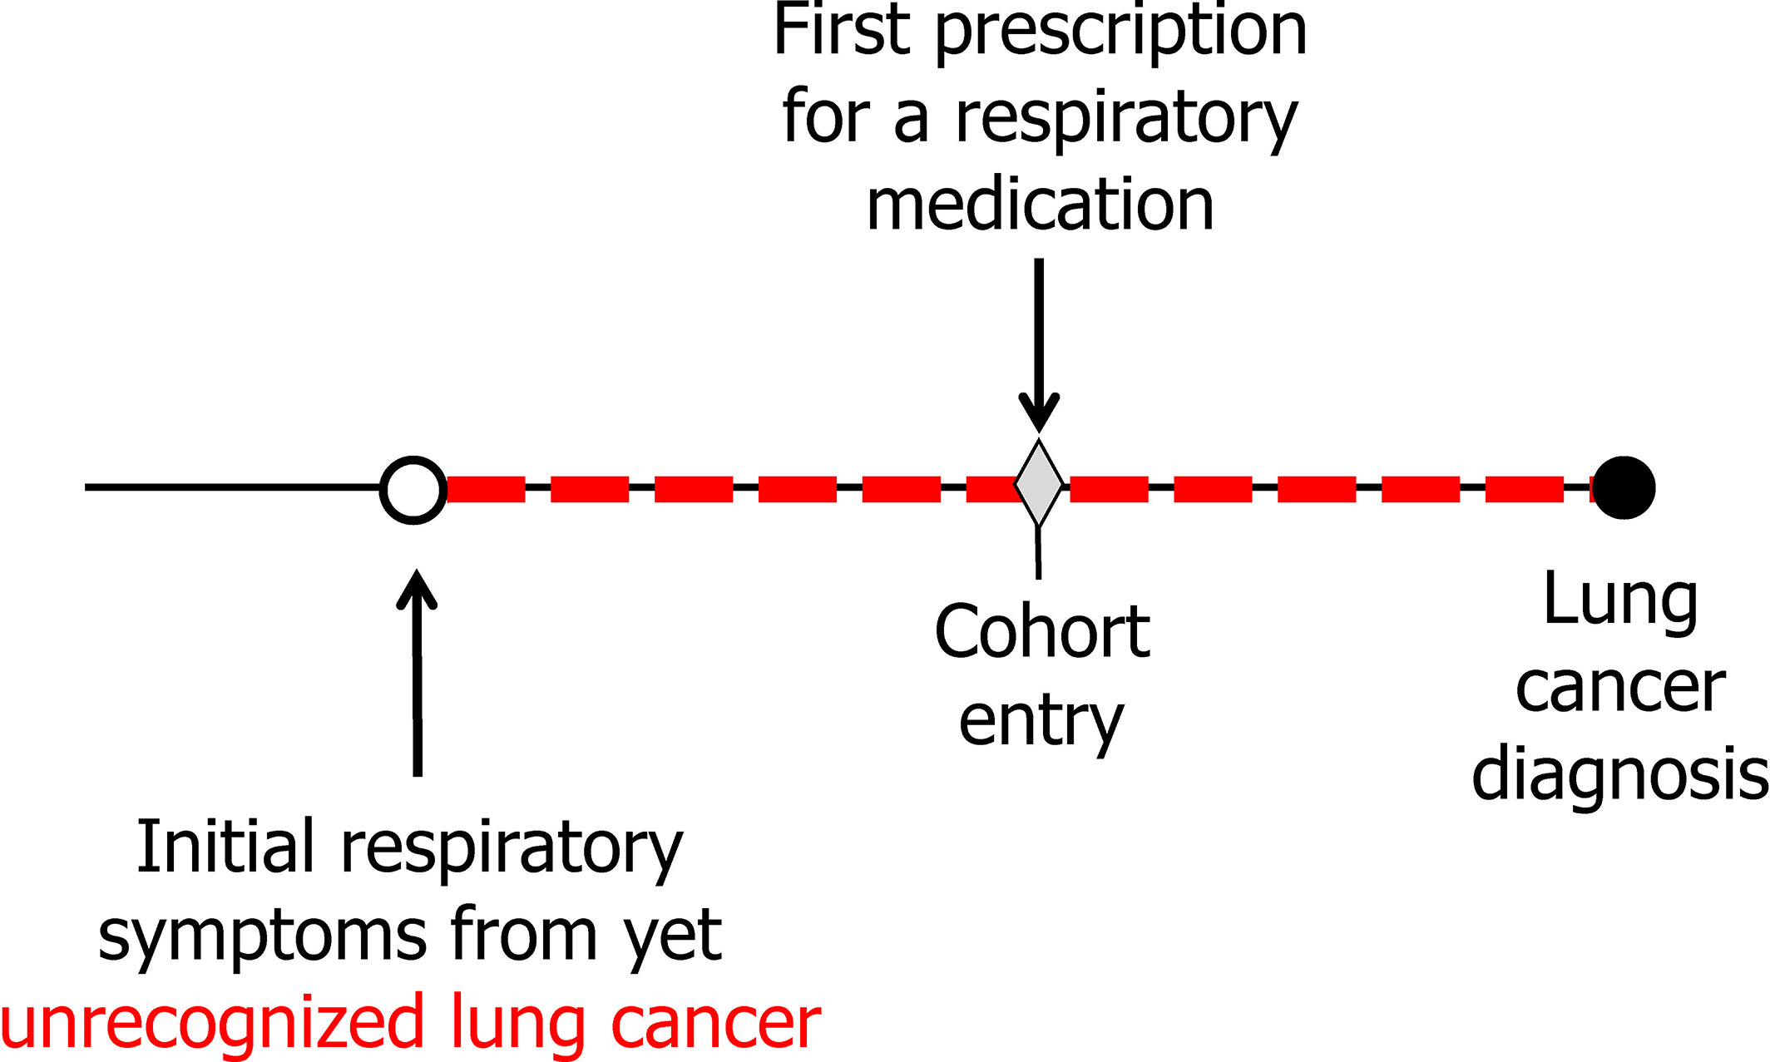
Protopathic Bias
It occurs when the initiation of a medication (exposure) is in response to an early symptom of the outcome under study.

Slide 48
Protopathic Bias
It occurs when the initiation of a medication (exposure) is in response to an early symptom of the outcome under study.

Slide 49
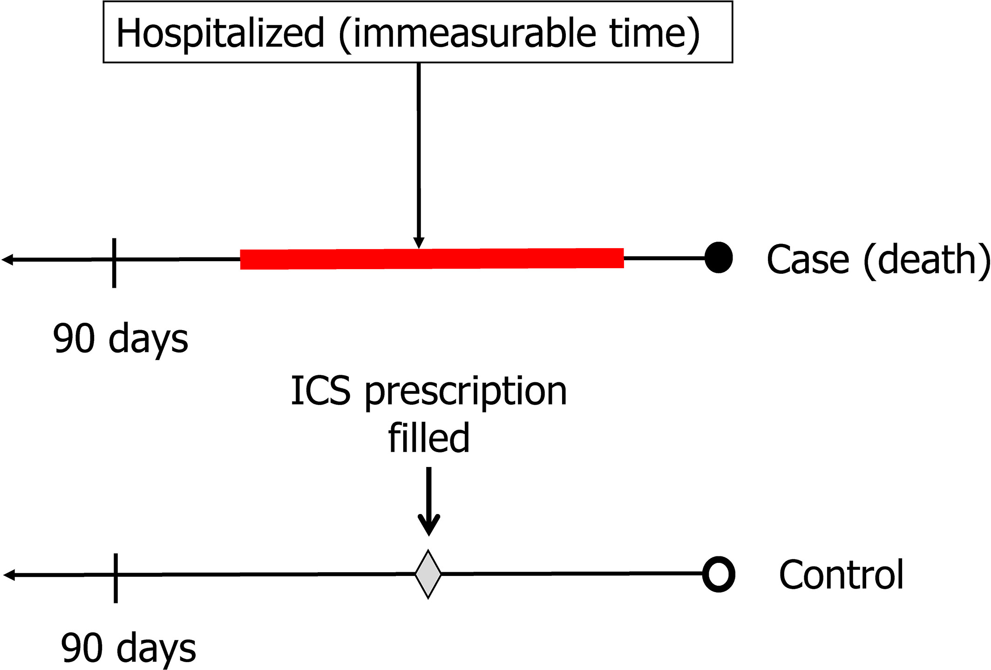
Immeasurable time bias
It refers to a period of time during follow-up, during which a subject cannot be recognized as being exposed.
For example, we would like to evaluate the association between inhaled corticosteroids and death in a case-control study. However, we have only outpatients data, which means patients admission data are not available.

Slide 50
How to prevent measurement bias
Use reliable and validated measurement tools.
Primary data could help minimizing the measurement bias such as immeasurable time bias.

Slide 51
Final remarks
Observational studies are important; yet, it requires comprehensive critical thinking in all stages.
Good observational studies address potential biases (all observational studies have biases)
It is advised to think through biases during protocol writing; it is a teamwork effort.

Slide 52
Thank you
For questions
yalbogami@ksu.edu.sa

